Slide 1
UNIT 1: INTERPRETATION
1: The Value of Data + Data Narratives
2: Excel Fundamentals
3: Data Referencing
4: Data Aggregation
5: Data Visualization
6: Statistics in Excel*
James Larkin – Data Analytics Instructor
Notes:
* Indicates a FLEX lesson

Slide 2
VISUALIZATION IN EXCEL

Slide 3
LEARNING OBJECTIVES
VISUALIZATIONS IN EXCEL
In today’s lesson, we will:
Learn strategies for visualizing data in Excel
Identify best practices for different types of graphs.
Create scatterplots, line graphs, and dashboards.

Slide 4
BIG PICTURE
Plotting is an important aspect of data analysis! Visualizing data helps convey the overall story of your data.
Visualized data can be easier to interpret than raw numbers or standardized tables, BUT - when done incorrectly, a poor visual can contribute to misleading conclusions.
To create honest, easily understood visualizations, keep it simple.

Slide 5
VISUALIZATION HISTORY
INTRODUCTION: BRIEF HISTORY OF VISUAL ANALYTICS

Slide 6
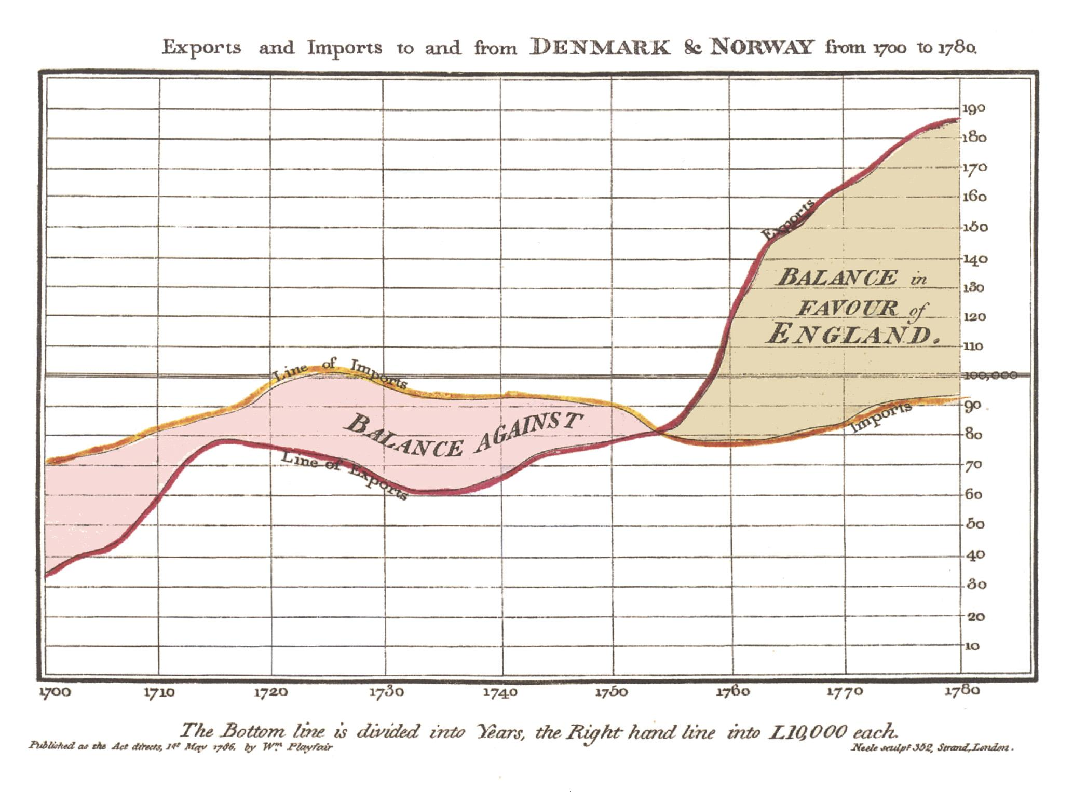
VIZ HISTORY: WILLIAM PLAYFAIR (1786)
Playfair’s visualization published in the Commercial and Political Atlas in 1786.
Notes:
Instructor Talking Point: Great data visualization is both an art and a science. Let’s look at some historical examples for context.

Slide 7
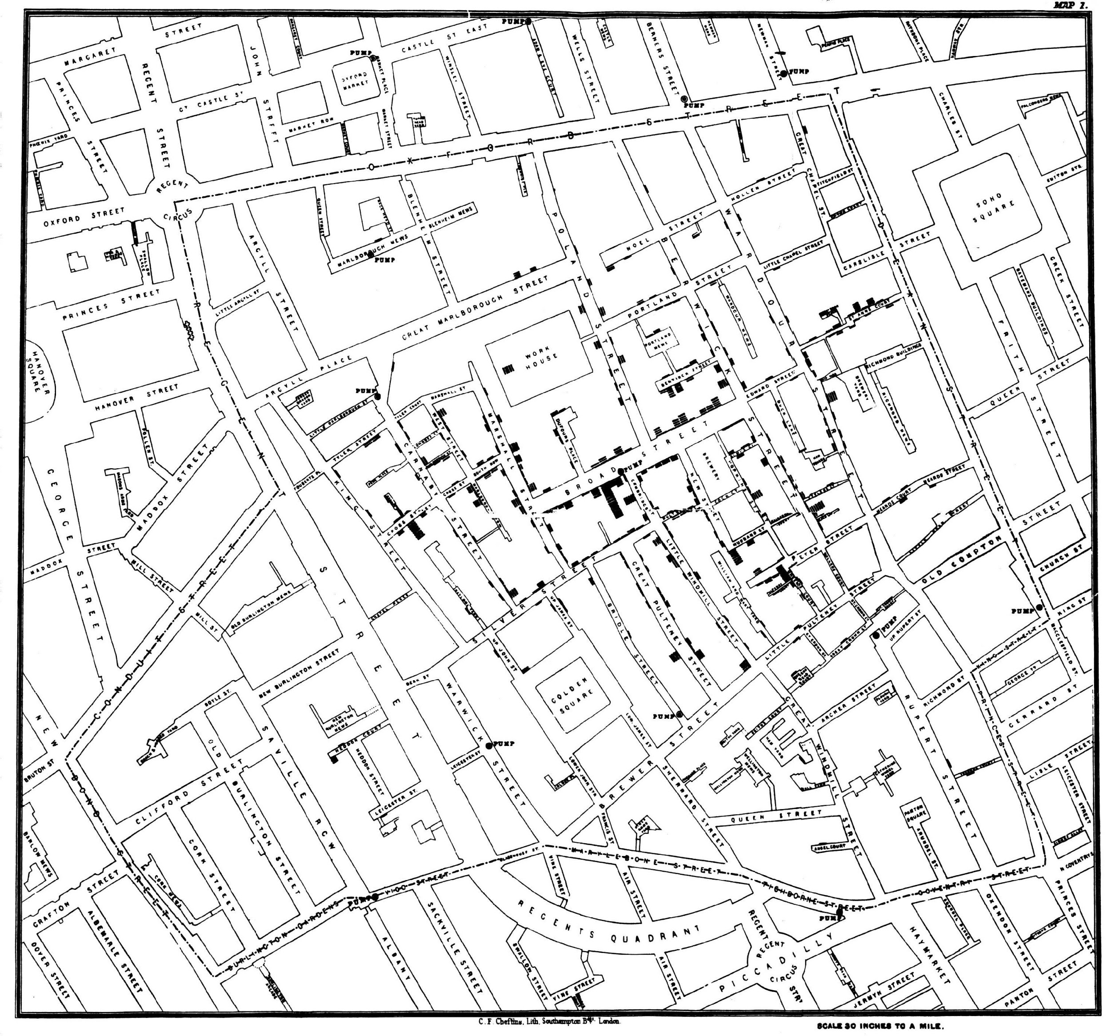
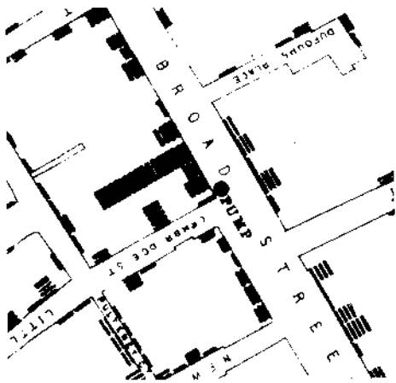
VIZ HISTORY: JOHN SNOW (1854)
Snow’s Cholera Map in London, 1854 (charting where 500 died over a 10-day period).

Slide 8
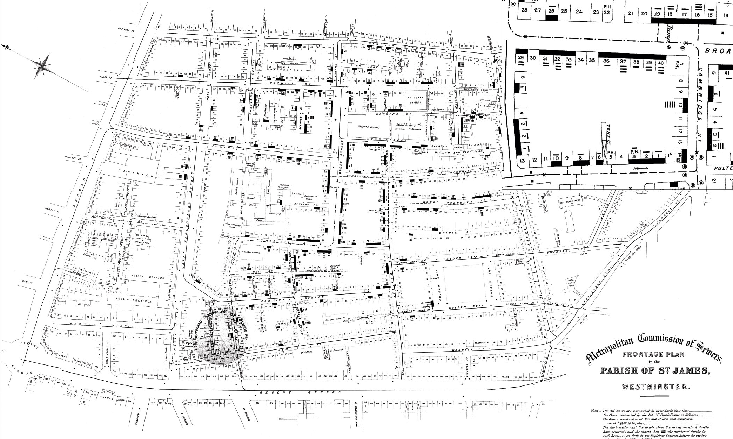
VIZ HISTORY: JOHN SNOW (1854)

Slide 9
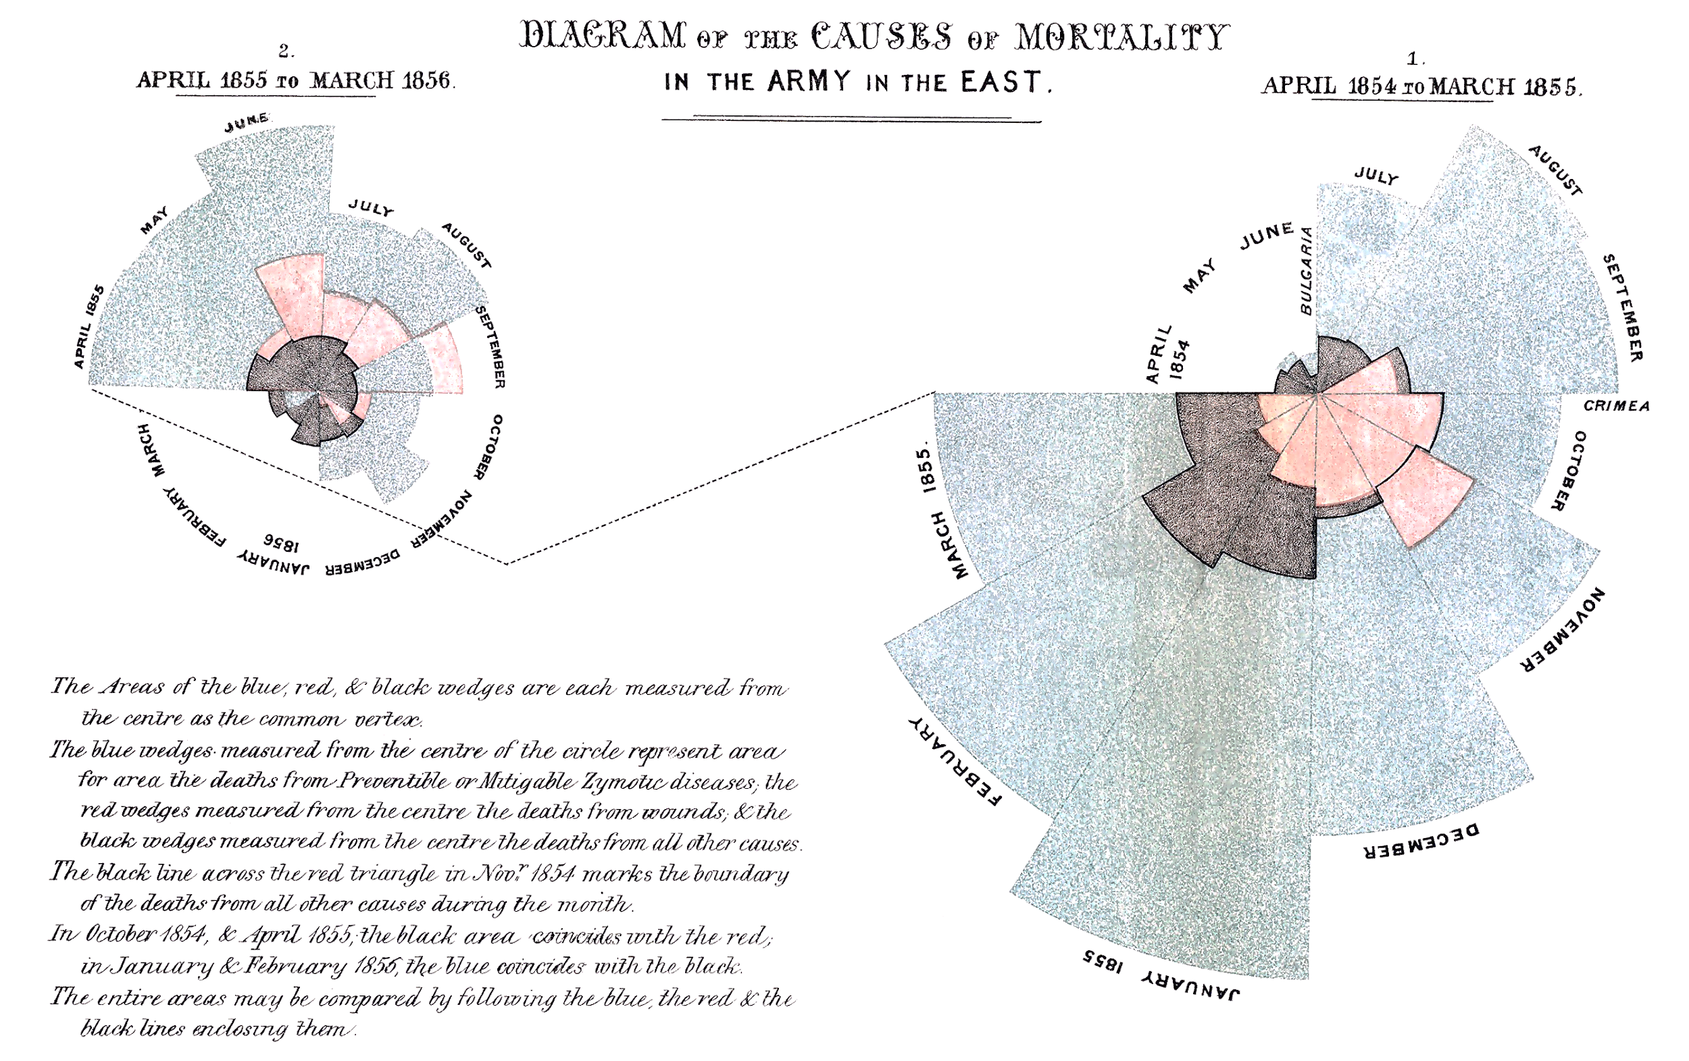
VIZ HISTORY: FLORENCE NIGHTINGALE (1858)
Nightingale’s “Coxcomb” visualization of the causes of death during the Crimean War (1854–56).

Slide 10
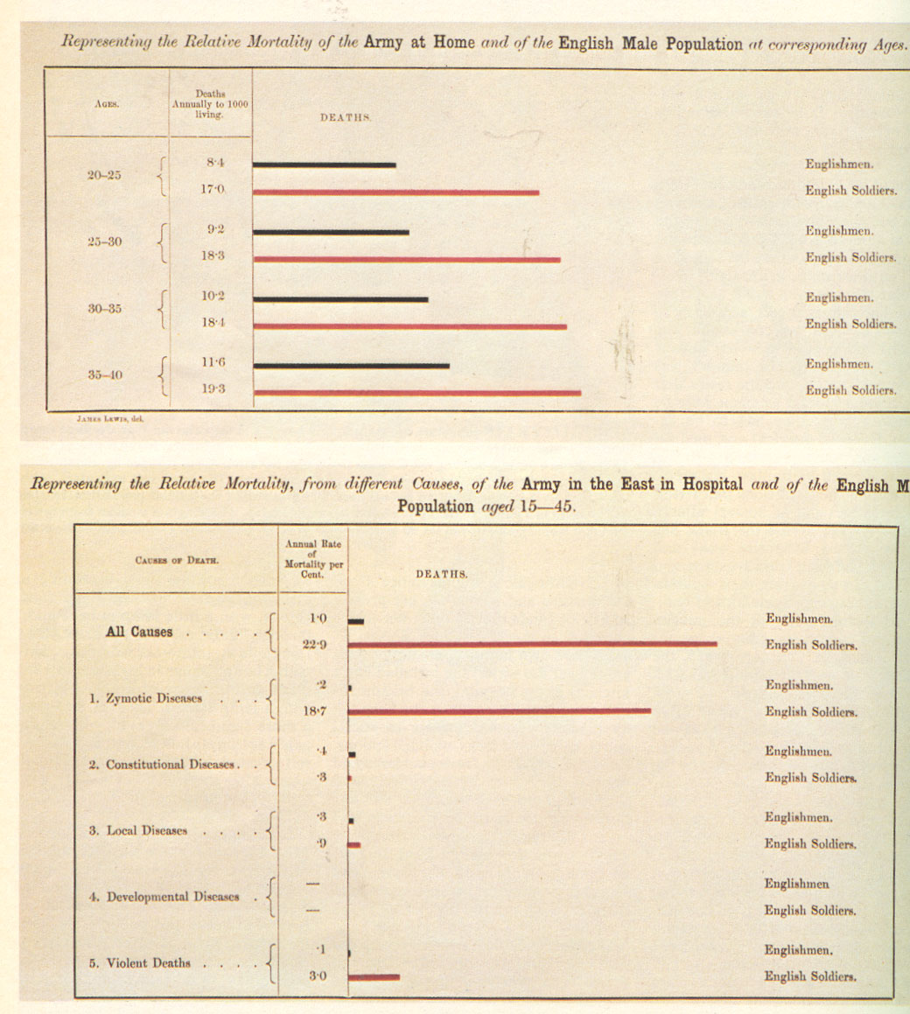
VIZ HISTORY: FLORENCE NIGHTINGALE (1858)
Nightingale’s bar-chart visualization of relative mortality, presented to Parliament.

Slide 11

VIZ HISTORY: CHARLES MINARD (1869)
Minard’s visualization of Napoleon’s disastrous march into Russia between 1812–13.

Slide 12
DATA NARRATIVES
DISCUSSION: HOW TO SELECT THE RIGHT VISUALS FOR YOUR GOALS

Slide 13
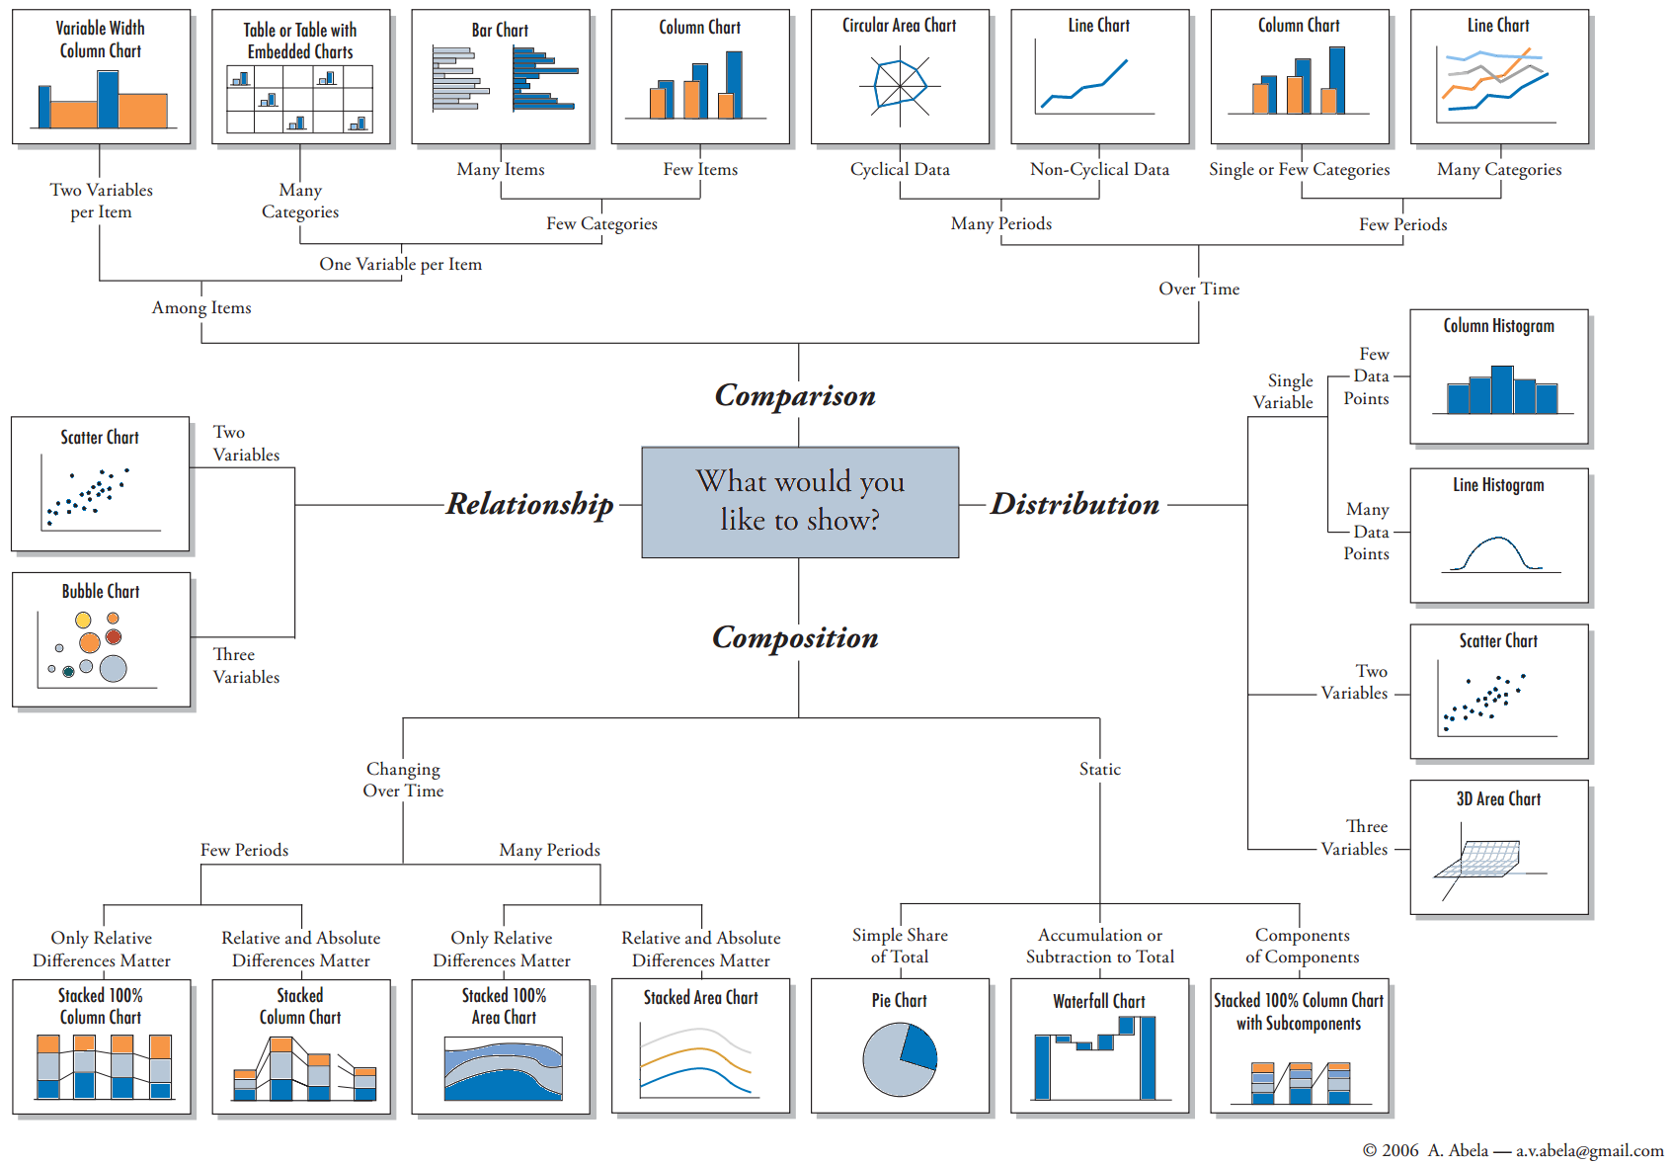
VISUALIZATION TYPES
Notes:
Instructor Notes: The following chart organizes common data visualization methods into four distinct categories, defined by suggested use case. These are not strict rules but serve as a helpful starting point when approaching a problem or planning a visualization. Prompt: Use the following four categories (comparison, distribution, composition, relationship) and associated charts as a reference when analyzing the examples provided on the following slides. What chart type did they use? What information were they trying to convey? Was this effective? Why or why not?
Composition - part of the whole

Slide 14
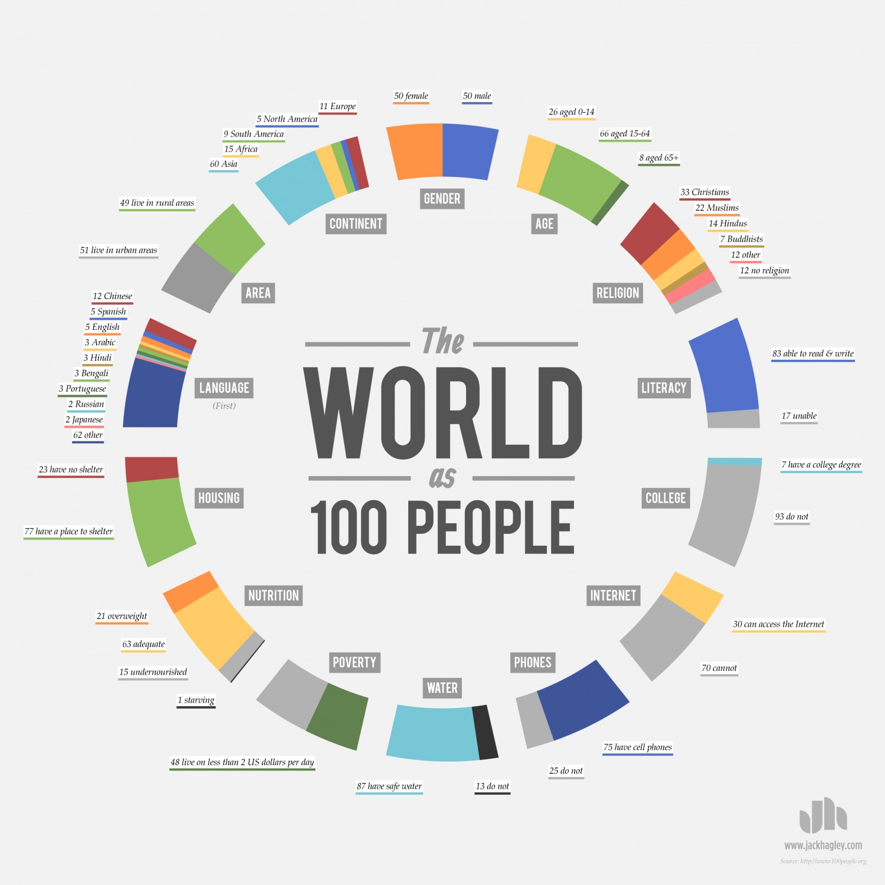
Notes:
Prompt: Use the following four categories (comparison, distribution, composition, relationship) and associated charts as a reference when analyzing the examples provided on the following slides. What chart type did they use? What information were they trying to convey? Was this effective? Why or why not?

Slide 15
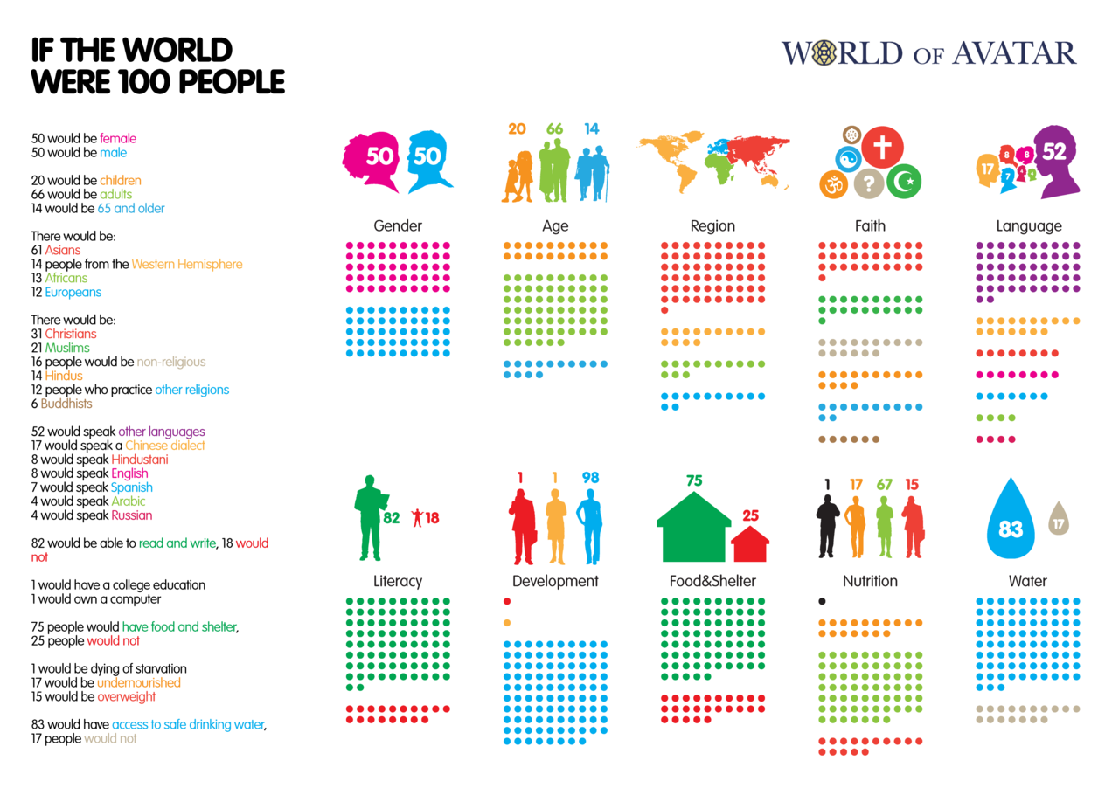
Notes:
Prompt: Use the following four categories (comparison, distribution, composition, relationship) and associated charts as a reference when analyzing the examples provided on the following slides. What chart type did they use? What information were they trying to convey? Was this effective? Why or why not?

Slide 16
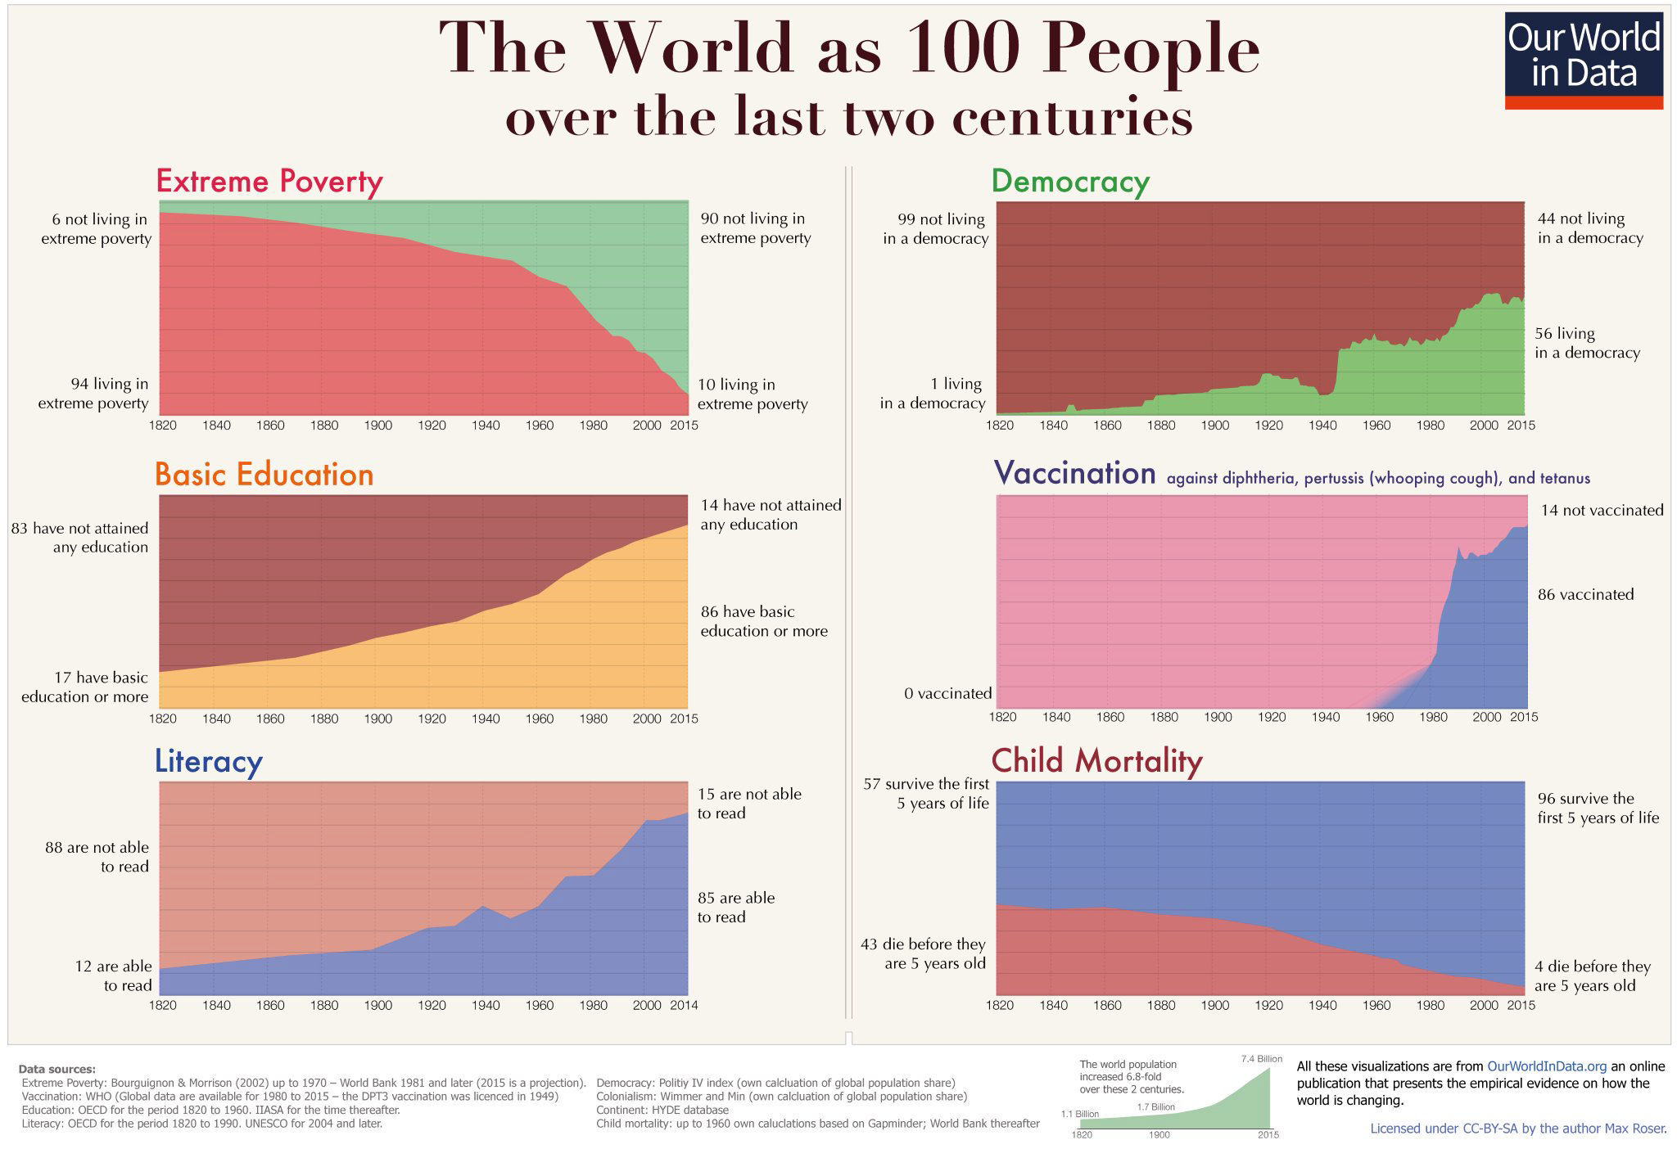
Notes:
Prompt: Use the following four categories (comparison, distribution, composition, relationship) and associated charts as a reference when analyzing the examples provided on the following slides. What chart type did they use? What information were they trying to convey? Was this effective? Why or why not?

Slide 17
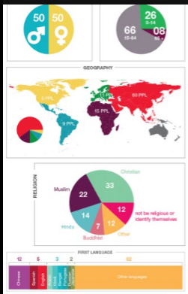

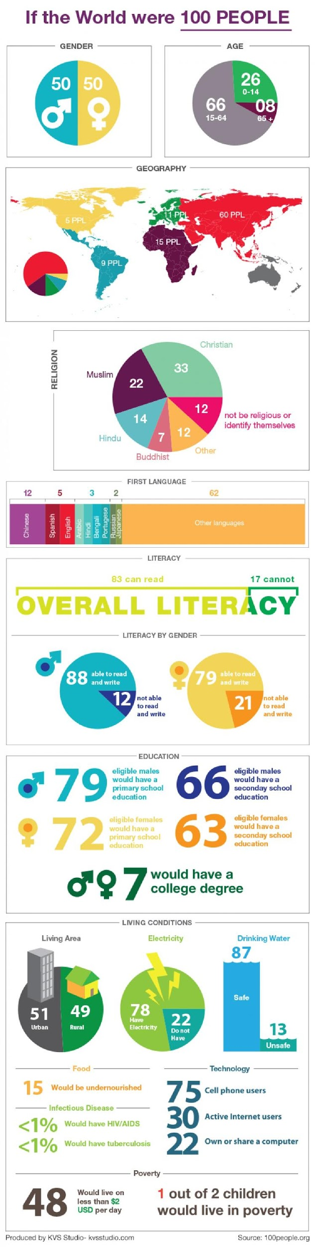
THE WORLD AS 100 PEOPLE, MOBILE
Notes:
Prompt: Use the following four categories (comparison, distribution, composition, relationship) and associated charts as a reference when analyzing the examples provided on the following slides. What chart type did they use? What information were they trying to convey? Was this effective? Why or why not?

Slide 18
VISUALIZATIONS IN EXCEL
SCATTERPLOTS

Slide 19
WHAT ARE SCATTERPLOTS?
A scatterplot is a chart generated by mapping numeric values to a pair of perpendicular/orthogonal axes.
Each scattered dot represents a data point at the intersection of two attributes, mapped to the x and y axes.

Slide 20
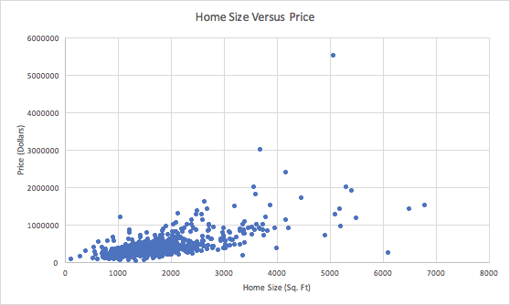
SCATTERPLOTS: Uniform Dots

Slide 21
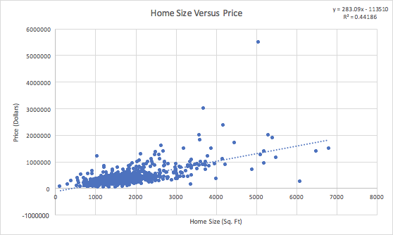
SCATTERPLOTS: With Trend Line

Slide 22
SCATTERPLOTS: With Colored Dots
Scatterplot with colored dots:
A scatterplot can be enhanced by mapping the color of the dots to an additional attribute (the same way we just did with size).
Color coding can be used both to map both a categorical and a numeric attribute, but typically works best for the former.

Slide 23
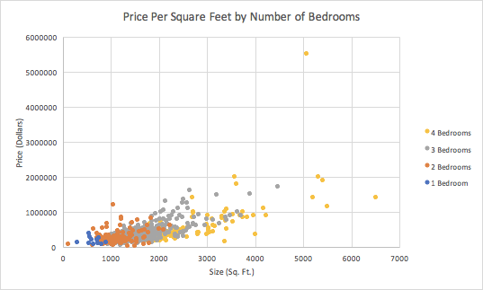
SCATTERPLOTS: With Colored Dots

Slide 24
SCATTERPLOTS: Bubble Charts
Bubble charts are scatterplots with a third numeric attribute, mapped to the size of the bubble (e.g., magnitude or scale).

Slide 25
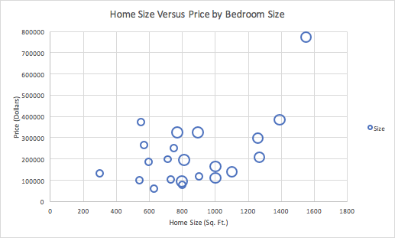
SCATTERPLOTS: Bubble Charts
Notes:
Instructor Talking Points: To indicate scale, change the size of data points. Be mindful of your data set here, as too much data can make the graph difficult to understand.

Slide 26
SCATTERPLOTS: Variants
A combination of bubble and colored dots: In the following figure, you can see how we map size with color while at the same time effectively mapping a total of four attributes in one plot.

Slide 27
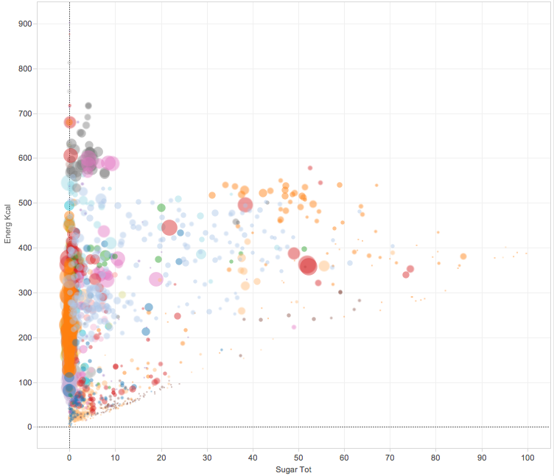
SCATTERPLOTS: Variants
Notes:
Note: Size = Scale

Slide 28
USE CASES AND DRAWBACKS
Use case:
To show the association between two, three, or four variables.
Drawbacks:
The biggest issue with a scatterplot is the amount of data. If there are too many data points, the chart may be too cluttered to show useful information.
Mapping color to an attribute with many categories — it’s hard to distinguish more than five or six colors.
If the data is highly skewed, the dots may all be concentrated in a small area.

Slide 29
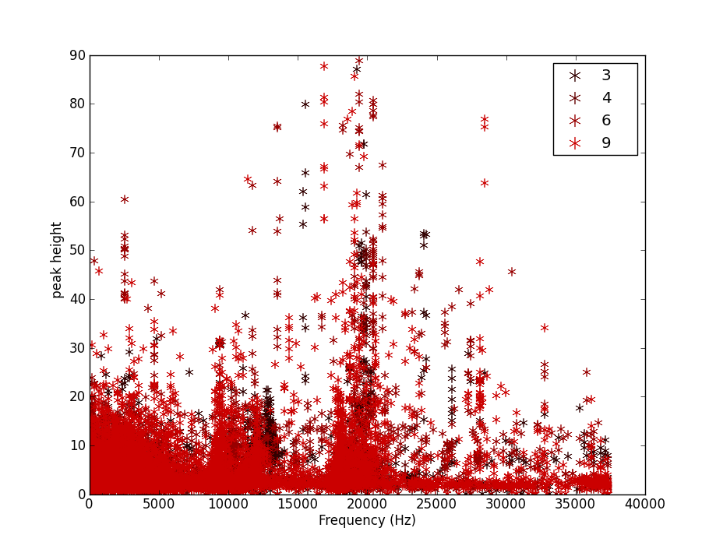
KEEP PLOTS SIMPLE
Notes:
NOTE: complexity diminishes comprehension!!

Slide 30
VISUALIZATIONS IN EXCEL
GUIDED PRACTICE: HOW TO CREATE SCATTERPLOTS IN EXCEL

Slide 31

ACTIVITY: CREATE SCATTERPLOTS
DIRECTIONS
EXERCISE
Open AN_lesson_5_intro_to_line_graphs.xlsx
Recreate the scatterplot from the “Assignment” tab (10 min).
DELIVERABLE
Completed scatterplots.

Slide 32
VISUALIZATIONS IN EXCEL
LINE GRAPHS

Slide 33
WHAT ARE LINE GRAPHS?
Line graphs consist of at least two axes: X and Y.
The X-axis is horizontal; used to represent independent (e.g. natural) variables.
The Y-axis is vertical; data plotted to Y are generally dependent on X.
Line graphs generally map an ordered variable (e.g. time) with a changing quantity.
For example, a time series analysis represents time on the X-axis, and maps data that changes over time on the Y-axis, such as stock prices.

Slide 34
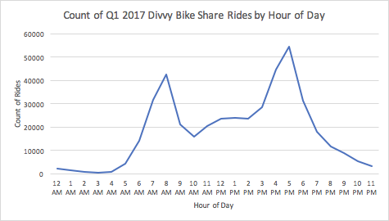
LINE GRAPH: BEST PRACTICES
The x intervals should be equally spaced.
The y values should indicate the scale.
Avoid 3-D graphs when you only have two axes.

Slide 35
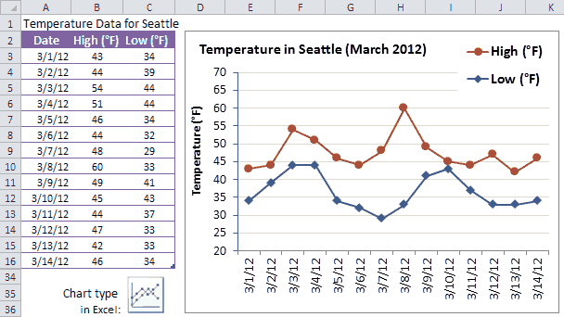
LINE GRAPH: BEST PRACTICES
Notes:
Talking Points: What does this graph do well?

Slide 36
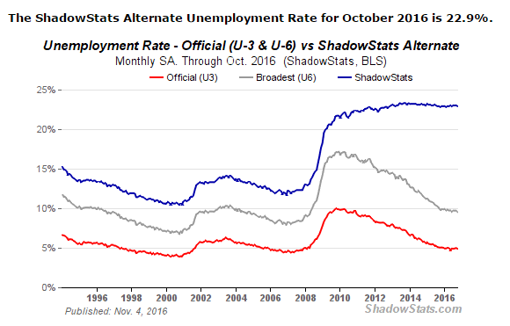
LINE GRAPH: BEST PRACTICES
Notes:
Talking Points: What does this graph do well?

Slide 37
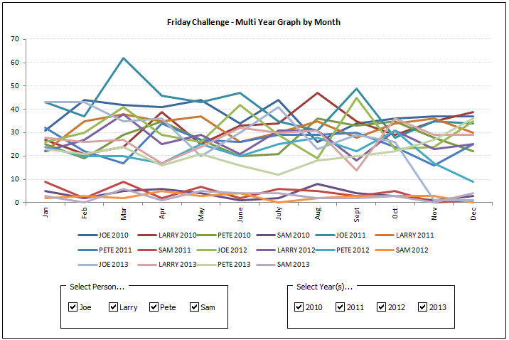
LINE GRAPH: POOR EXAMPLES
Notes:
Talking Points: What is wrong with this example? Answer: TOO MUCH DATA

Slide 38
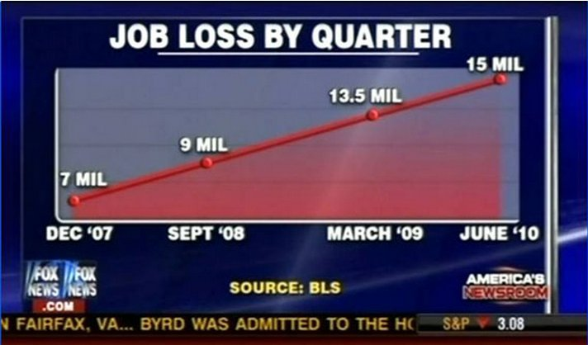
LINE GRAPH: POOR EXAMPLES
Notes:
Talking Points: What is wrong with this example? Answer: SCALING IS MISLEADING

Slide 39
VISUALIZATIONS IN EXCEL
GUIDED PRACTICE: HOW TO CREATE LINE GRAPHS IN EXCEL

Slide 40
ACTIVITY: CREATE LINE GRAPHS
DIRECTIONS
EXERCISE
Open AN_lesson_5_intro_to_line_graphs.xlsx
Follow instructions from the “Assignment” tab (10 min).
DELIVERABLE
Completed line graphs.

Slide 41
VISUALIZATIONS IN EXCEL
DASHBOARDS

Slide 42
DASHBOARDS
Dashboards are easy-to-read displays of data, often presented on a single page with a real-time user interface that shows:
A graphical representation of the current data.
Historical trends of key performance indicators (KPIs).
Dashboards are often used in a progress report or a deep dive into a specific issue. These may include a collection of powerful Excel formulas to aggregate data and save lookup time.

Slide 43
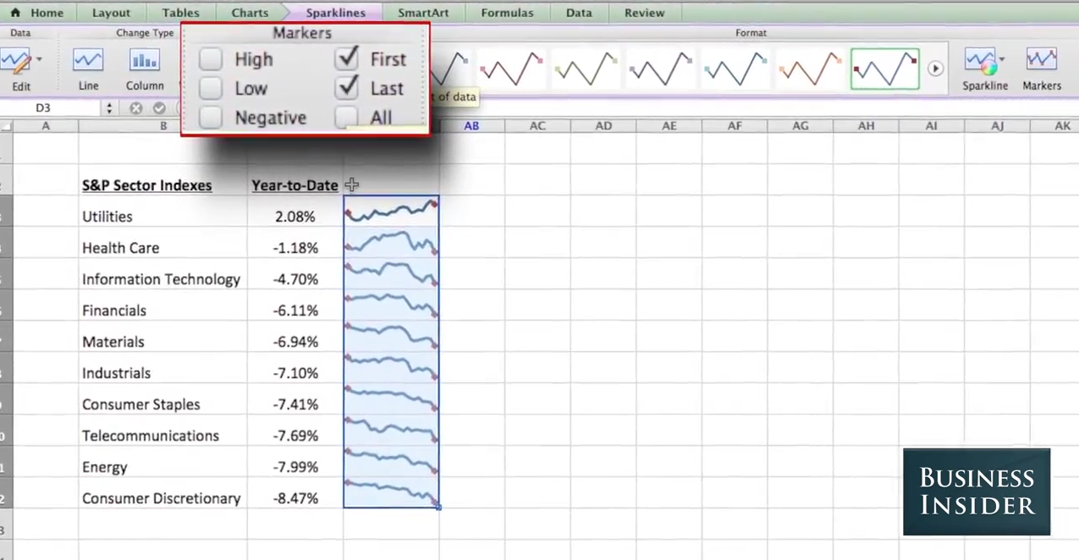
LINE GRAPH ALTERNATIVES
Notes:
Talking Points: What type of graph are we looking at here? Answer: SPARKLINES

Slide 44
DASHBOARD DESIGN
Here’s a general workflow to follow when designing a dashboard:
Collect requirements.
Determine the data sets that are necessary to visualize.
Design visualizations offline.
Get approval and feedback from all parties.
Clean and QA data.
Create visualizations.
Notes:
Pro Tip: Not everything needs to be done with technology. Sometimes it may be best to draw out a dashboard design on paper before getting started!

Slide 45
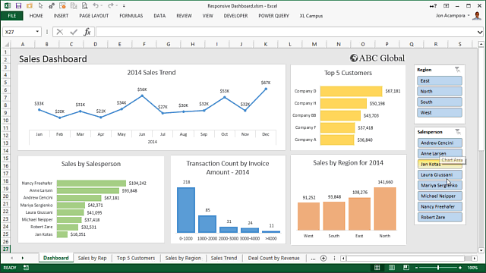
DASHBOARD DESIGN
Align your dashboards to their audience — emphasize relevance.
Design your dashboards to emphasize key takeaways.

Slide 46
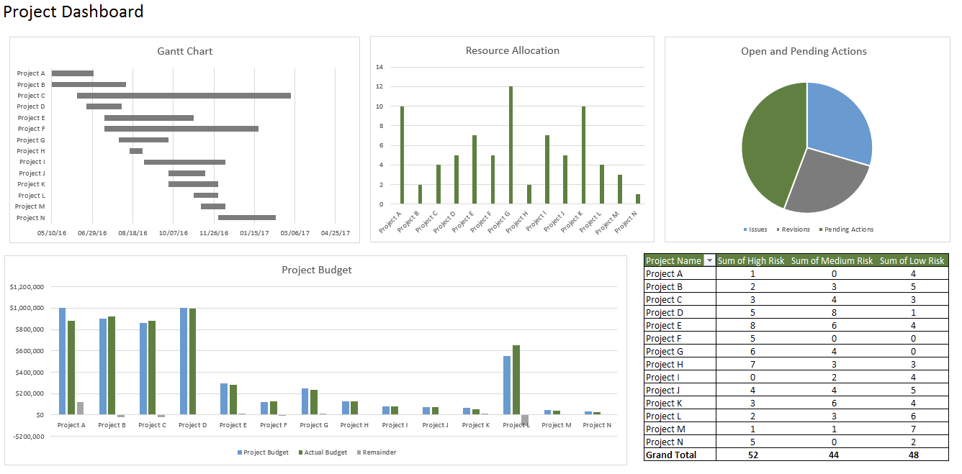
DESIGNING A DASHBOARD: QUESTIONS TO ASK
Are we trying to answer specific questions or monitor different events?
What is the root or key cause(s) of our question/problem?

Slide 47
DESIGNING A DASHBOARD: BEST PRACTICES
When designing your dashboard, use the following checklist:
Do my dashboard visualizations answer relevant business questions?
Does my dashboard layout draw attention to my main ideas?
Have I labeled and titled my data?
Are my top metrics prominently displayed?
Did I include a legend that clearly indicates all elements shown?

Slide 48
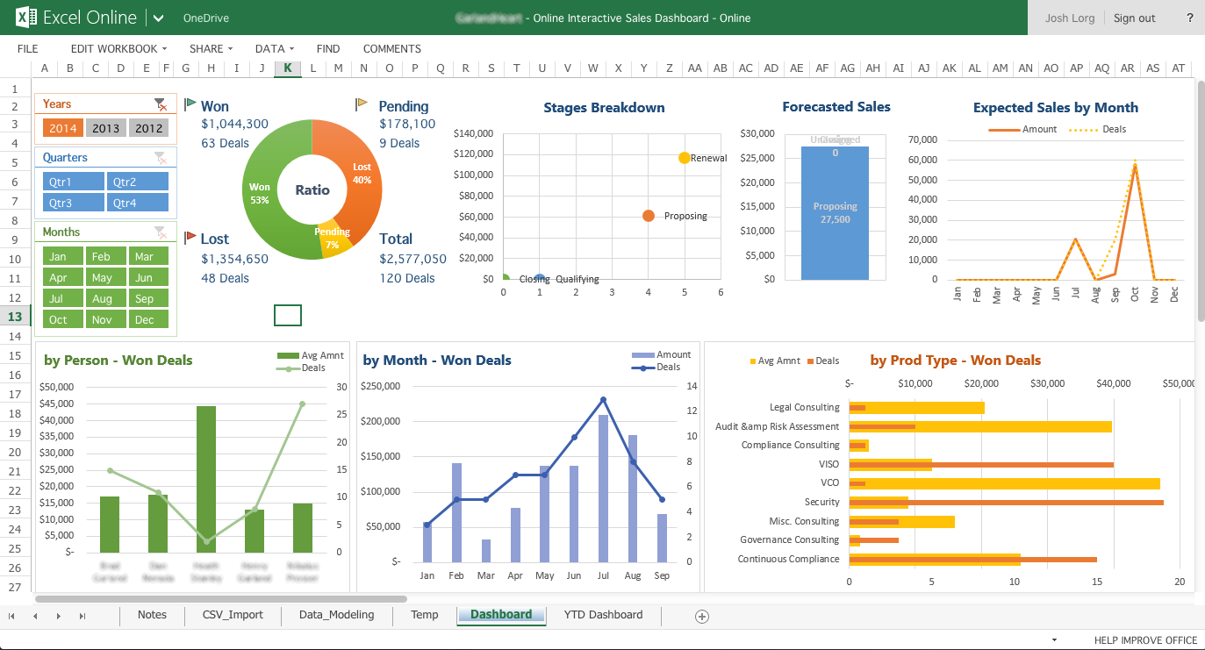
DESIGNING A DASHBOARD: BEST PRACTICES
Notes:
Instructor Notes: What does this dashboard do right? Does this follow our suggested guidelines? Why or why not?

Slide 49
DESIGNING DASHBOARDS: BEST PRACTICES
Make sure your dashboard is easily navigable. A best practice for this is to separate your data into three different tabs:
Presentation: Your first tab should contain all of your charts, graphs, and conditionally formatted tables. These should display the results from your Analysis tab.
Analysis: This tab contains all of the tools and formulas used for your analysis, including aggregations and PivotTables that pull from your Data tab.
Data: This tab should contain all of the raw data used for your analysis. This allows for quick edits or additions and ensures you can continue to use this dashboard over time.
Notes:
PRO TIP: Depending on your users, you may want to lock your Analysis tab so that no one can accidentally break your results. When designing dashboards for others, it’s a good idea to clearly indicate what *SHOULD* be edited/editable and what should *NOT* be messed with.

Slide 50
VISUALIZATIONS IN EXCEL
INDEPENDENT PRACTICE: CREATING VISUALIZATIONS

Slide 51
BREAK OUT ACTIVITY: USING AGGREGATE FUNCTIONS
DIRECTIONS
EXERCISE
Open AN_lesson_5_independent_practice.xlsx.
Based on your experience, choose to complete either the BASE or STRETCH tab (40 min).
You may work with a partner, checking in with each other after answering each question.
DELIVERABLE
Complete the BASE or STRETCH tab from AN_lesson_5_independent_practice.xlsx.

Slide 52
VISUALIZATIONS IN EXCEL
CONCLUSION

Slide 53
WHAT DID WE LEARN?
We learned how to best design and use scatterplots and line graphs:
Scatterplots are created by graphing numeric values.
Line graphs are effective for plotting a value over time.
We also learned about dashboards and how they can be used to display many visualizations in one:
Dashboards are useful for displaying key performance indicators (KPIs), monitoring information over time, or sharing data-driven updates.
Dashboards should be clearly arranged and labeled for your audience.
Divide your dashboard data into 3 tabs: results, analysis, and raw data.

Slide 54
VISUALIZATIONS IN EXCEL
Q&A
Notes:
INSTRUCTOR NOTE: Are you teaching the optional Unit 1 FLEX LESSON: Data Analysis and Statistics in Excel?
NO: Make the next few slides visible in order to spend time on end of unit recap.
YES: Skip the invisible slides here; the end of unit recap is also provided at the end of the flex lesson.

Slide 55
VISUALIZATIONS IN EXCEL
RESOURCES

Slide 56
RESOURCES
VISUALIZATIONS IN EXCEL
Excel documentation on Microsoft’s website is helpful when looking up the arguments and behavior of Excel functions.
Tutorials on how to create charts and scatterplots in Excel.
Here is how to create Power Maps in Excel.
Best practices for graphing and displaying data.
Dashboard design and sample Excel dashboards.
Here are some free productivity dashboard templates.

Slide 57
VISUALIZATIONS IN EXCEL
EXIT TICKET
DON’T FORGET TO FILL OUT YOUR EXIT TICKET!

Slide 58
VISUALIZATIONS IN EXCEL
CREDITS

Slide 59
CITATIONS
VISUALIZATIONS IN EXCEL
Diamond data set from ggplot2’s R package: http://docs.ggplot2.org/0.9.3.1/diamonds.html
Divvy Bike Share: https://www.divvybikes.com/system-data
GDP Data: http://www2.stat.duke.edu/~mw/data-sets/ts_data/gdp
House Pricing Data: https://wiki.csc.calpoly.edu/datasets/wiki/Houses
World Bank Life Expectancy: https://data.worldbank.org/indicator/SP.DYN.LE00.IN
World Bank Life Fertility: https://data.worldbank.org/indicator/SP.DYN.TFRT.IN
Stock Prices: https://finance.yahoo.com/quote/aapl/history/
Note: Change dates for each individual stock quote and export as csv

